Slide 1
Albert Pike Camp
St. Louis Chapter # 22

Slide 2
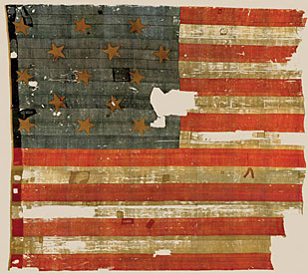
Our National Anthem The Star-Spangled Banner

Slide 4
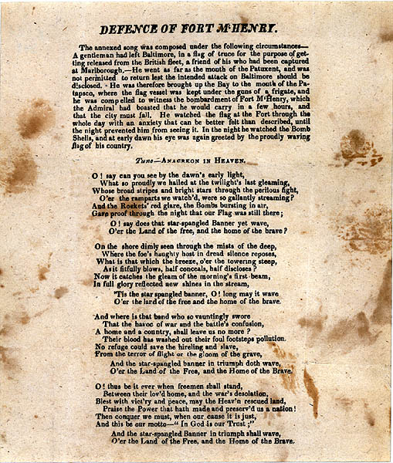

Slide 7
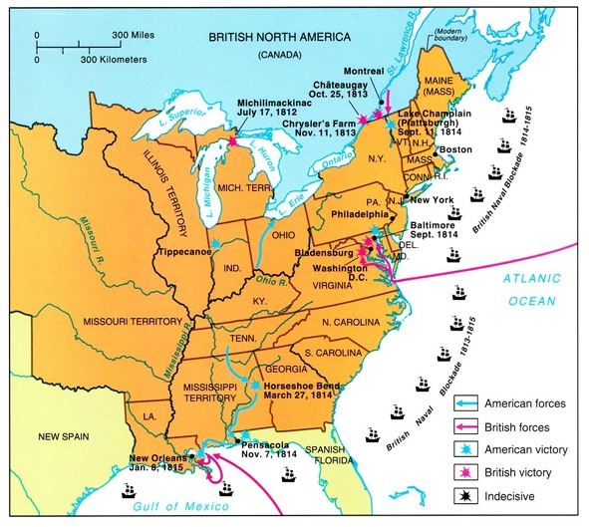

Slide 8
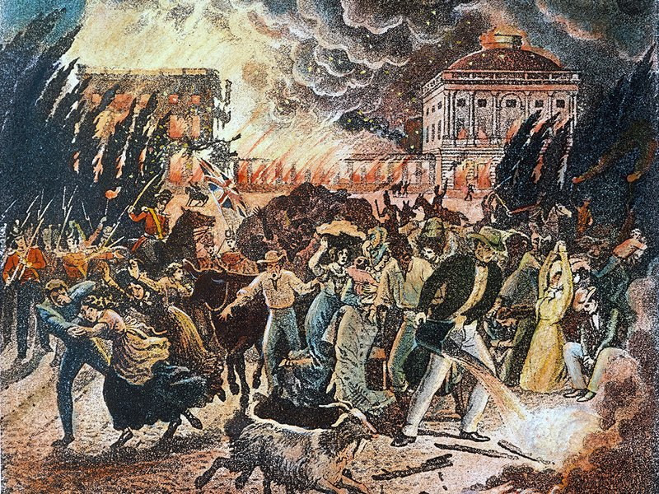
Burning of Washington D.C. in 1814

Slide 9
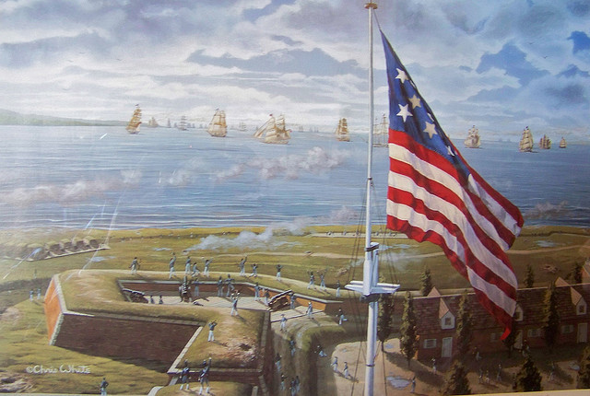

Slide 10
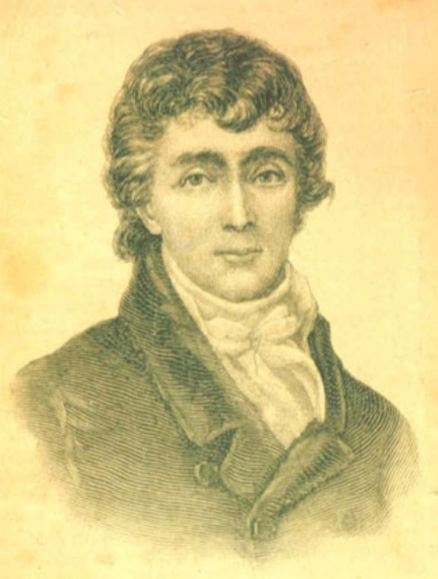
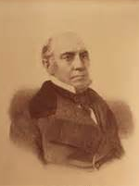
John Stuart Skinner
Francis Scott Key

Slide 11
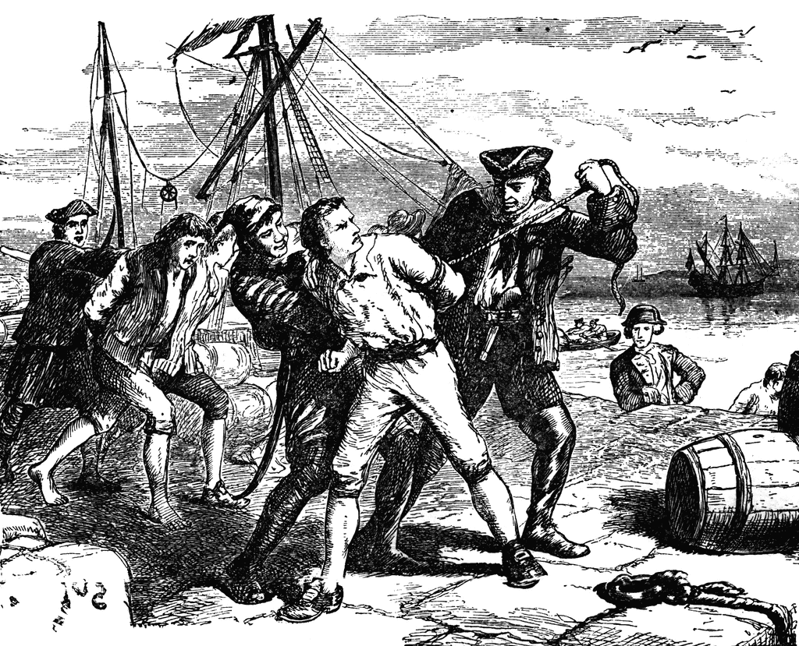

Slide 12
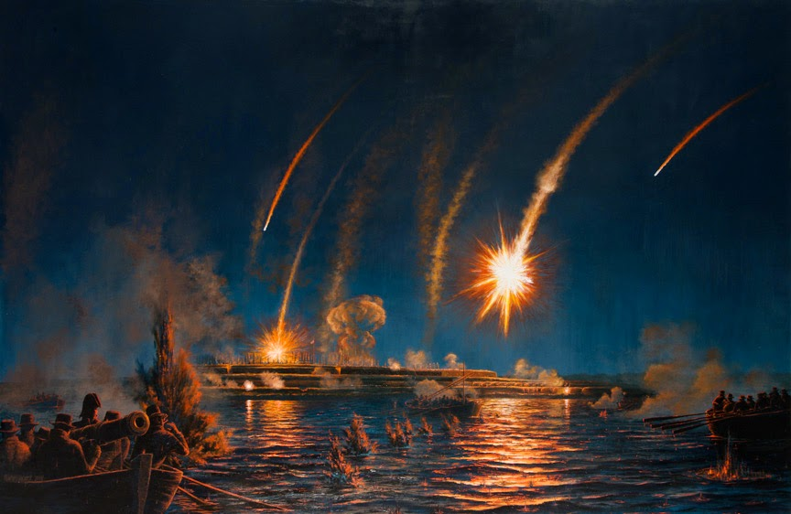

Slide 13
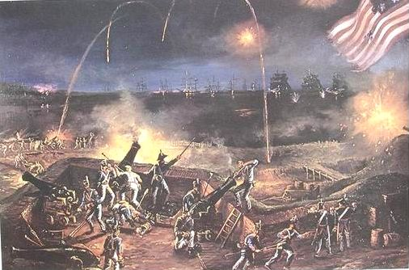

Slide 14
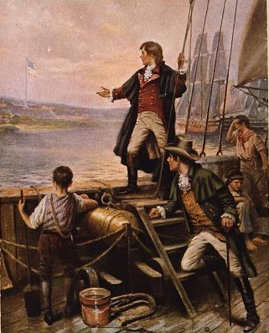

Slide 15
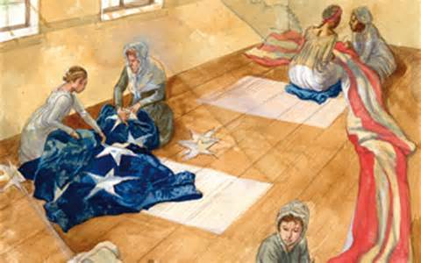
Mary Pickersgill and workers
sewing Fort McHenry garrison flag

Slide 16
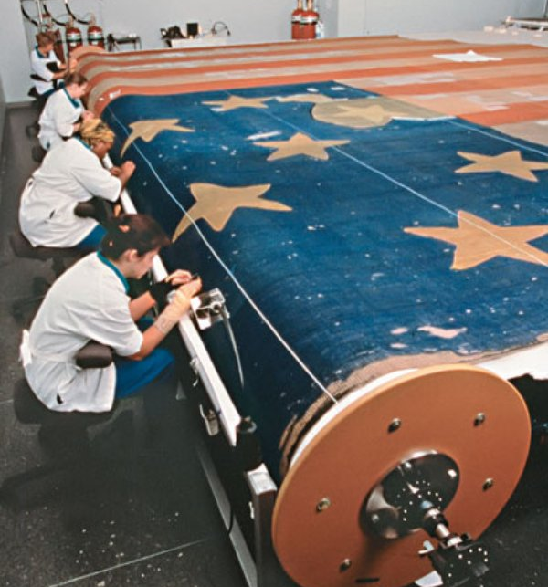

Slide 18
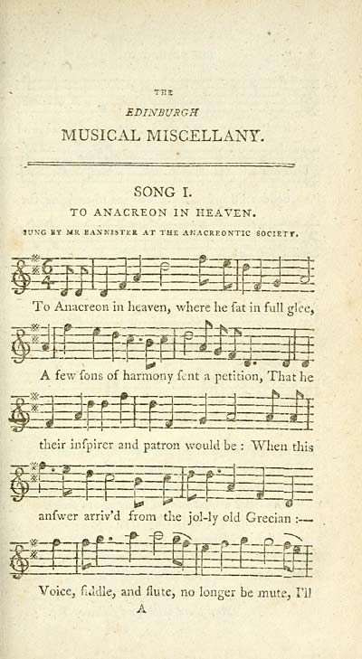
To Anacreon in Heaven

Slide 19
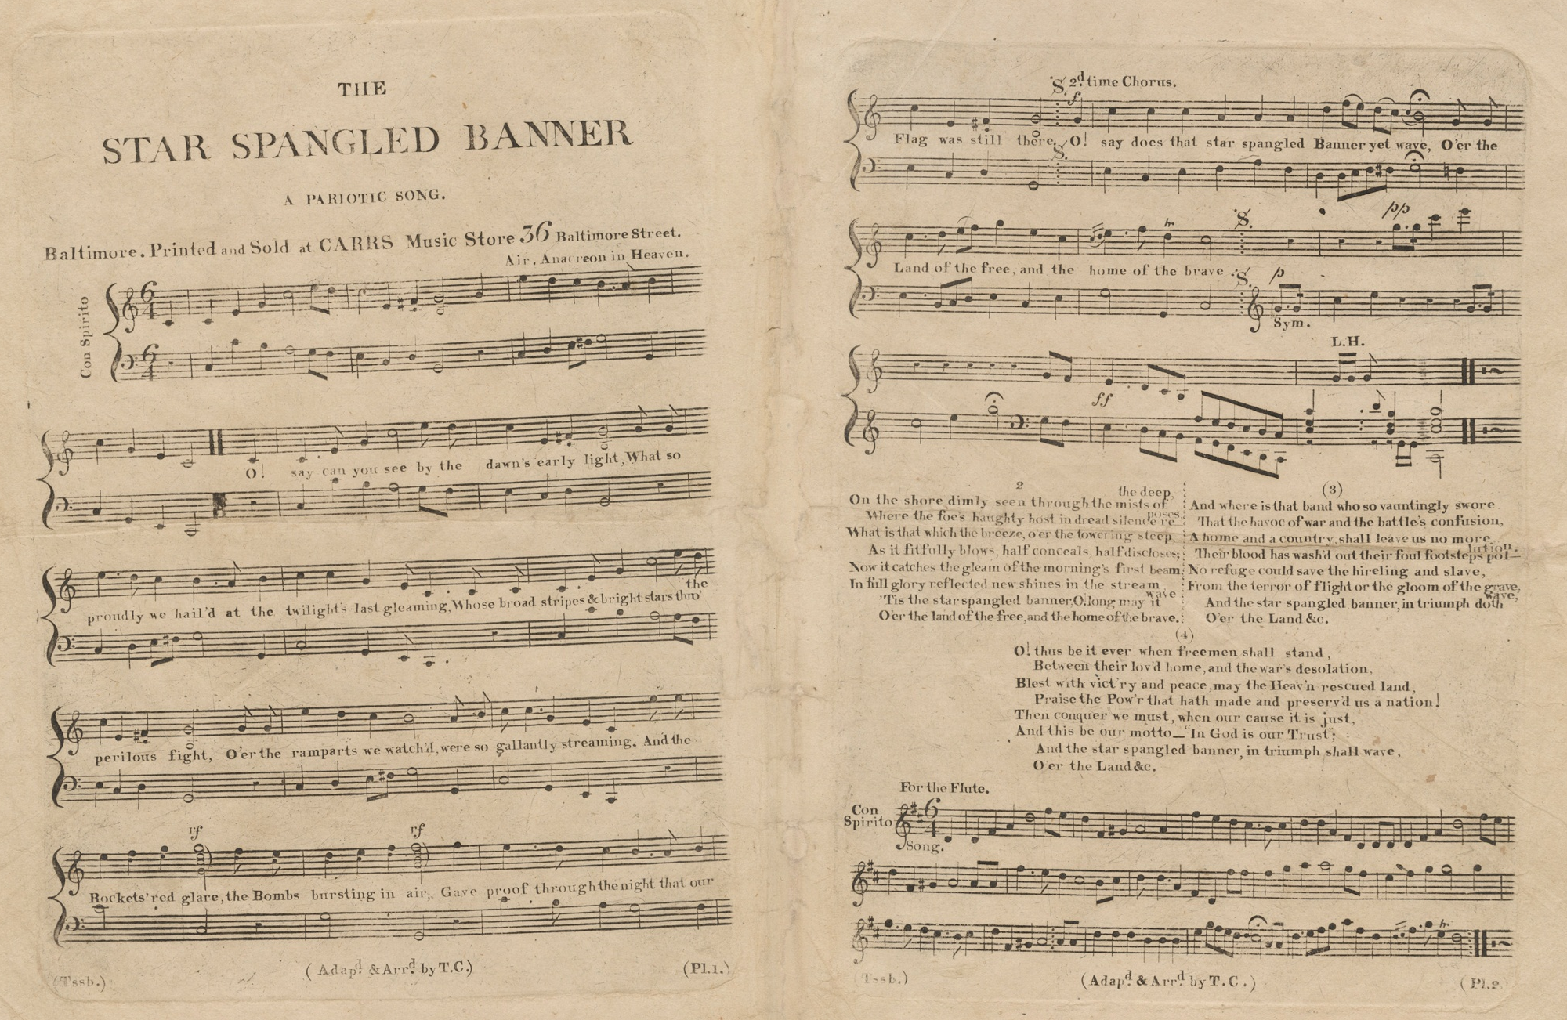

Slide 20
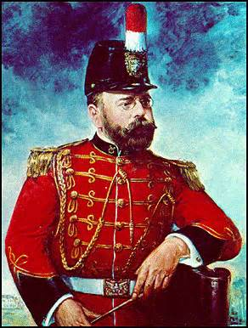
John Philip Sousa

Slide 21
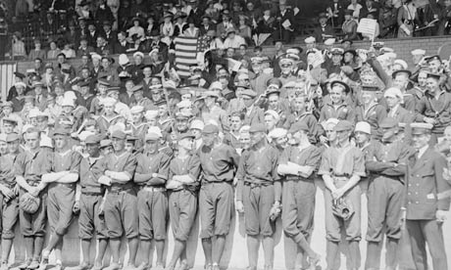

Slide 22
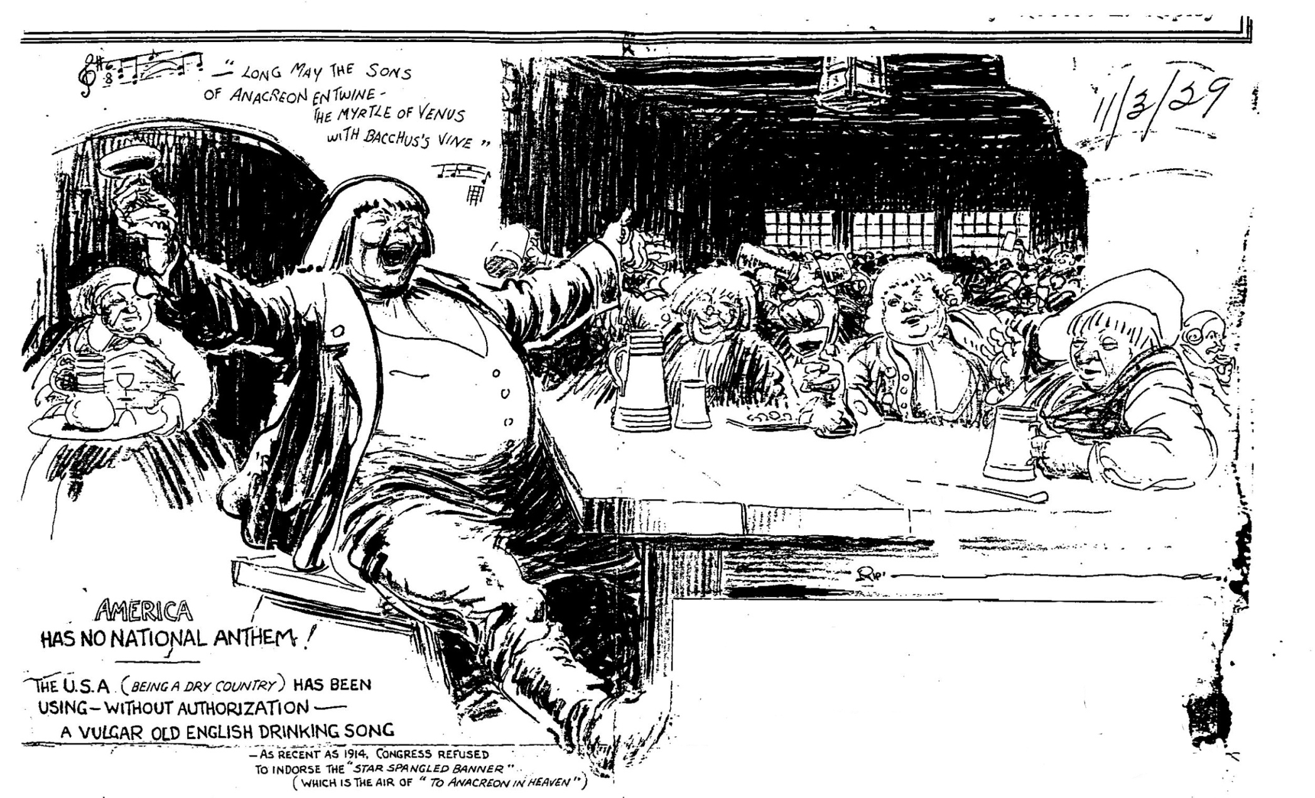
Ripley’s Believe it or Not! – November 3rd, 1929

Slide 23
O say can you see by the dawn's early light,
What so proudly we hailed at the twilight's last gleaming,
Whose broad stripes and bright stars through the perilous fight,
O'er the ramparts we watched, were so gallantly streaming?
And the rockets' red glare, the bombs bursting in air,
Gave proof through the night that our flag was still there;
O say does that star-spangled banner yet wave,
O'er the land of the free and the home of the brave?

Slide 24
On the shore dimly seen through the mists of the deep,
Where the foe's haughty host in dread silence reposes,
What is that which the breeze, o'er the towering steep,
As it fitfully blows, half conceals, half discloses?
Now it catches the gleam of the morning's first beam,
In full glory reflected now shines in the stream:
'Tis the star-spangled banner, O! long may it wave
O'er the land of the free and the home of the brave.

Slide 25
And where is that band who so vauntingly swore
That the havoc of war and the battle's confusion,
A home and a country, should leave us no more?
Their blood has washed out their foul footsteps' pollution.
No refuge could save the hireling and slave
From the terror of flight, or the gloom of the grave:
And the star-spangled banner in triumph doth wave,
O'er the land of the free and the home of the brave.

Slide 26
O thus be it ever, when freemen shall stand
Between their loved home and the war's desolation.
Blest with vict'ry and peace, may the Heav'n rescued land
Praise the Power that hath made and preserved us a nation!
Then conquer we must, when our cause it is just,
And this be our motto: "In God is our trust.“
And the star-spangled banner in triumph shall wave
O'er the land of the free and the home of the brave!

Slide 27
When our land is illumined with liberty's smile,
If a foe from within strikes a blow at her glory,
Down, down with the traitor that tries to defile
The flag of the stars, and the page of her story!
By the millions unchained, who their birthright have gained
We will keep her bright blazon forever unstained;
And the star-spangled banner in triumph shall wave,
While the land of the free is the home of the brave.

Slide 28
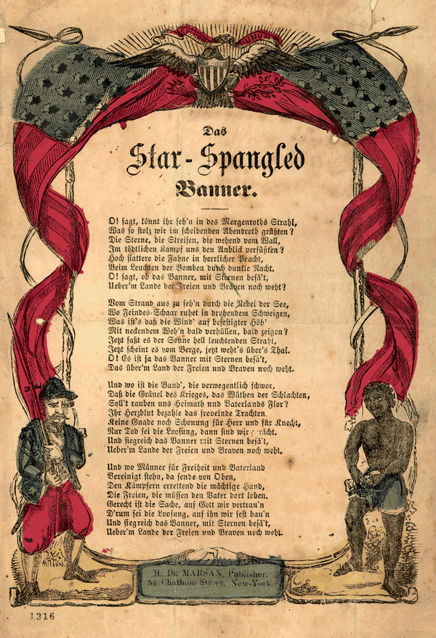
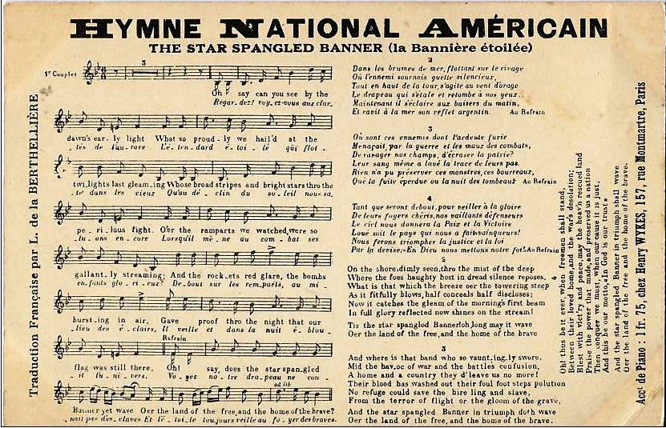

Slide 29
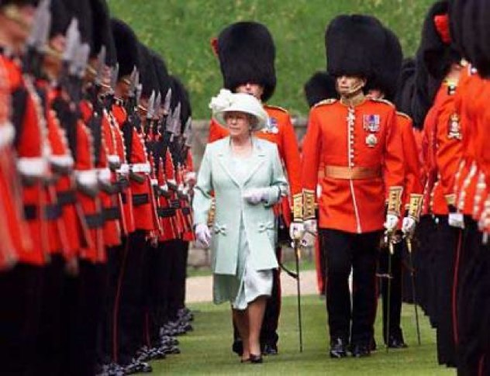
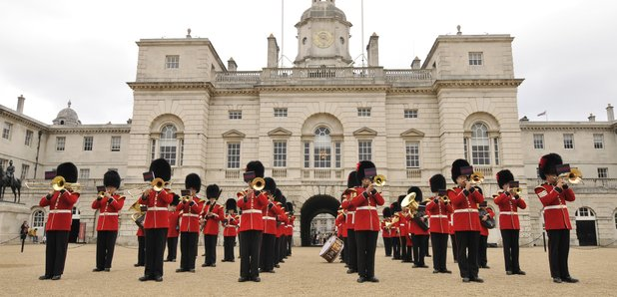
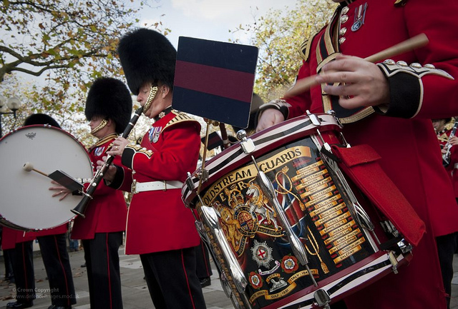
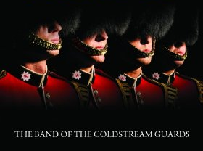

Slide 31
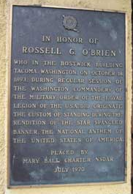
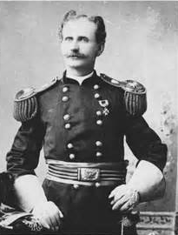

Slide 32
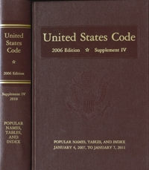
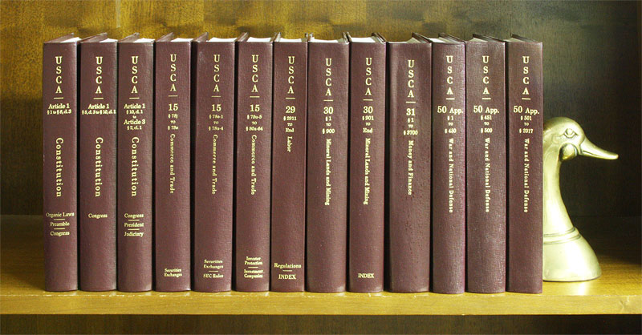

Slide 33
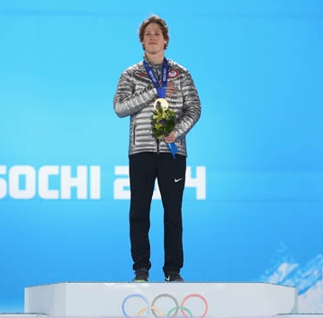
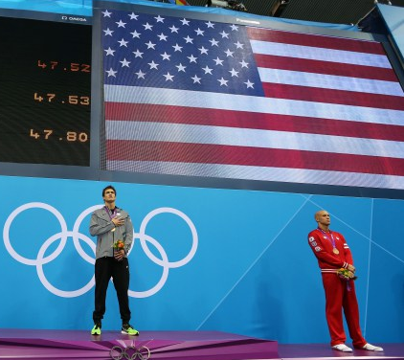
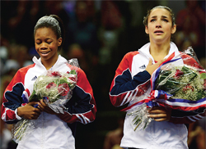

Slide 34
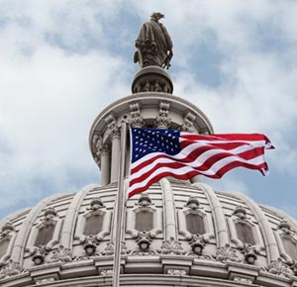

Slide 35
St. Louis Chapter #22
National Sojourners
Albert Pike Camp
Heroes of ‘76
Credits:
Our National Anthem – “The Star-Spangled Banner”
A Brief History
Script compiled and edited by: Paul A. DeMerath,
Past President/Past Commander
Slideshow compiled by: Peter G. Cauchon,
Past President/Past Commander
Much of the preceding program is from:
Dr. Isaac Asimov’s No Refuge Could Save
Slideshow Soundtrack from “Gods and Generals”

Slide 36
O say can you see by the dawn's early light,
What so proudly we hailed at the twilight's last gleaming,
Whose broad stripes and bright stars through the perilous fight,
O'er the ramparts we watched, were so gallantly streaming?
And the rockets' red glare, the bombs bursting in air,
Gave proof through the night that our flag was still there;
O say does that star-spangled banner yet wave,
O'er the land of the free and the home of the brave?

