Slide 2
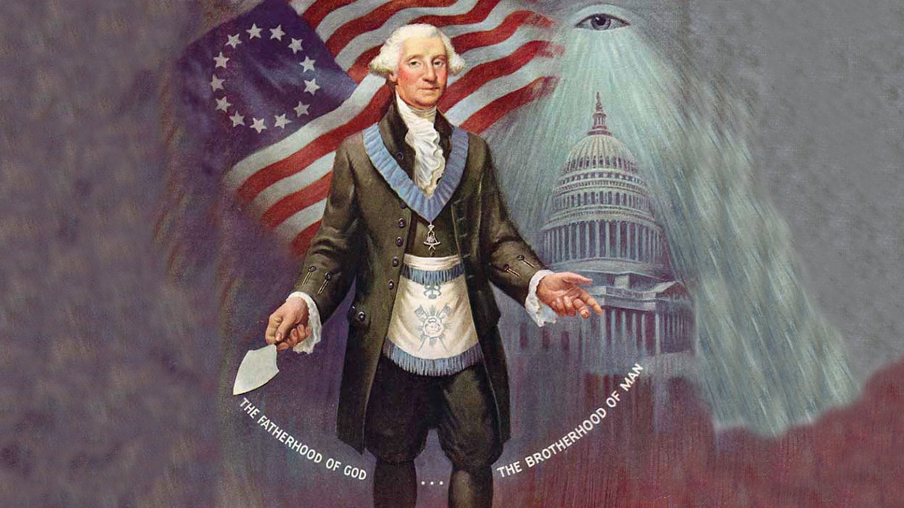
George Washington the Mason

Slide 3
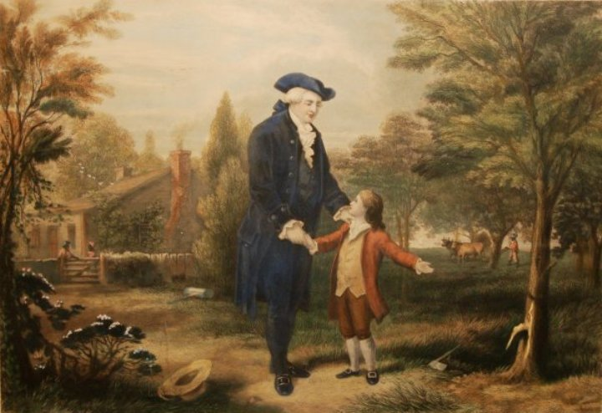
Augustine Washington
with young George

Slide 4
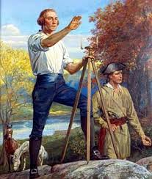
Washington the Surveyor

Slide 5
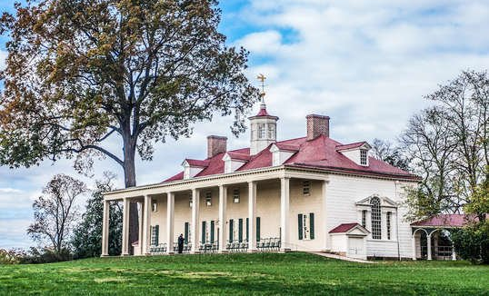
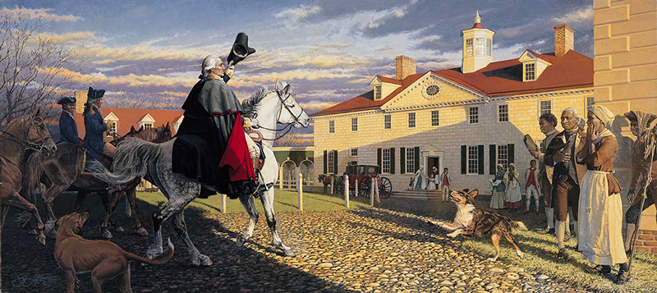
Mount Vernon

Slide 6
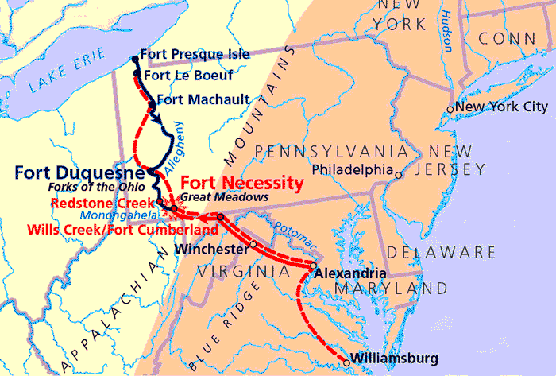
The French and Indian War

Slide 7
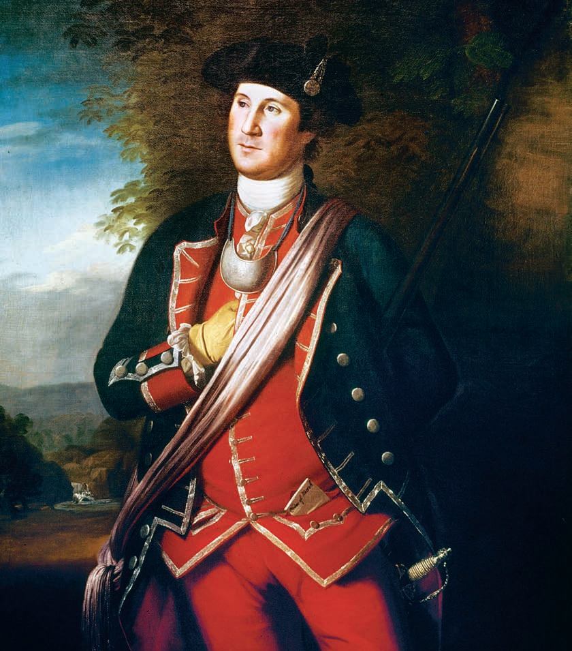
Colonel George Washington

Slide 8
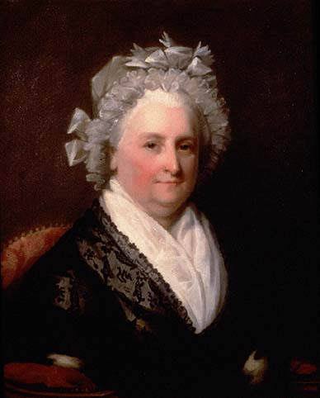
Martha Dandridge Custis

Slide 9
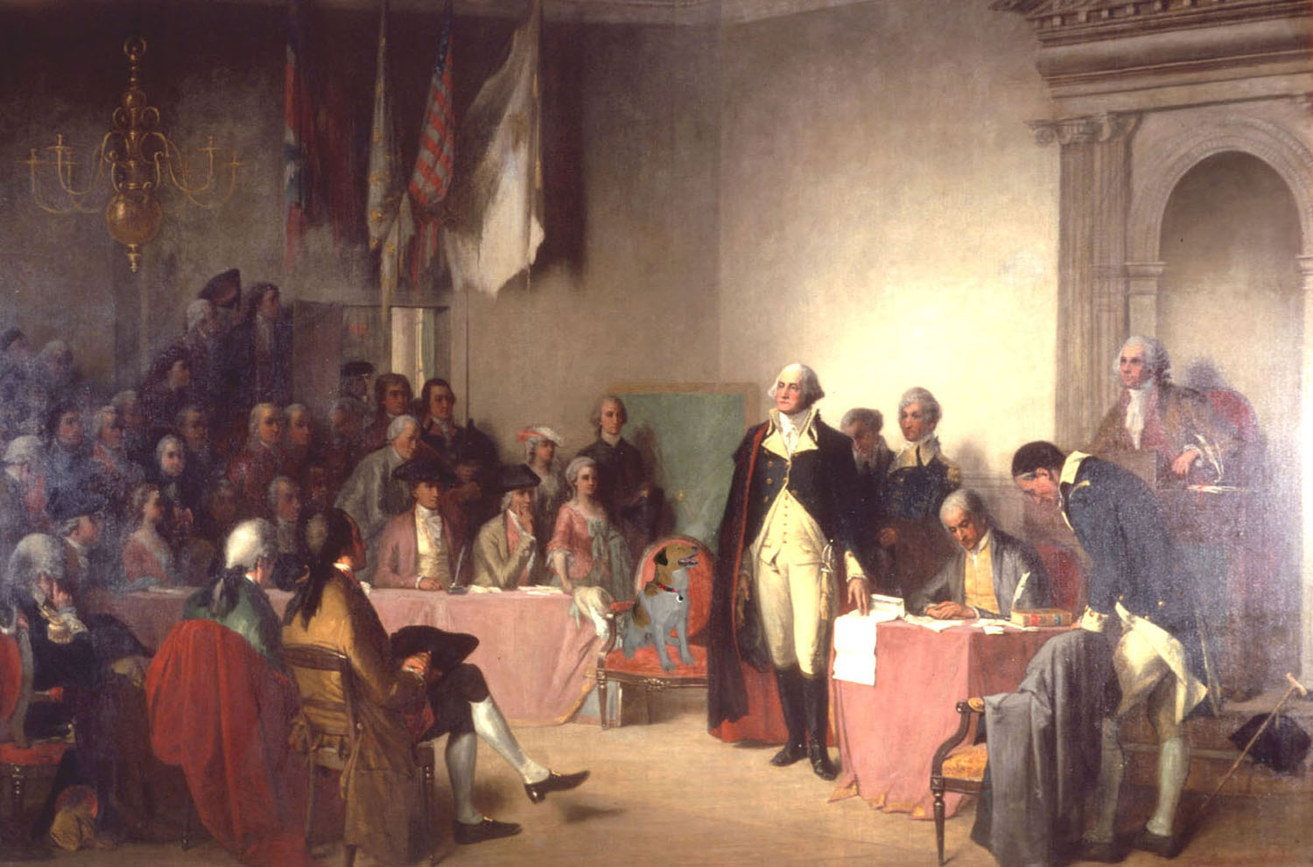
In Congress

Slide 10
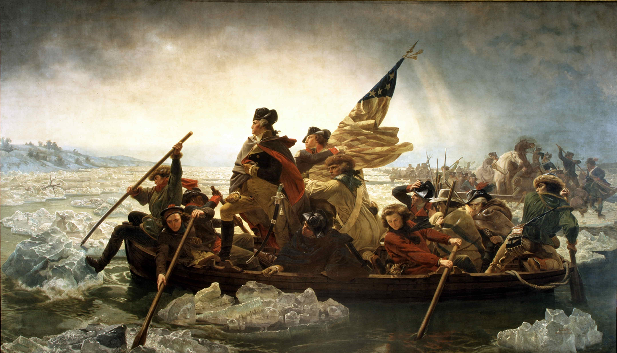
Crossing the Delaware

Slide 11
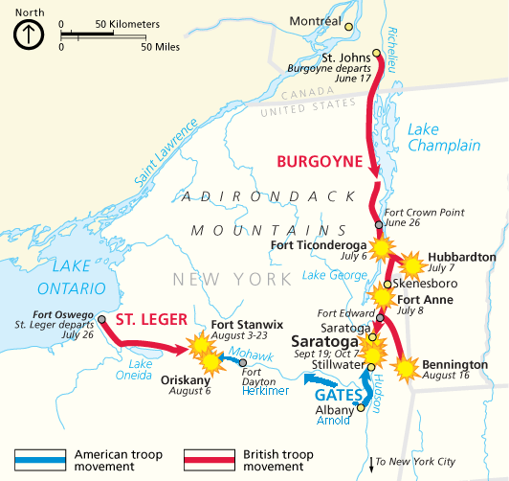
British Defeat at Saratoga

Slide 12
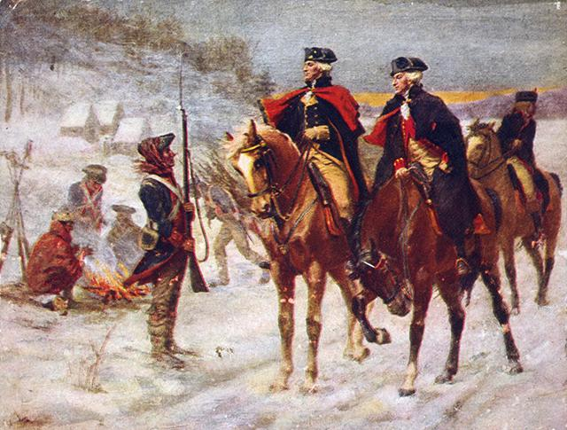
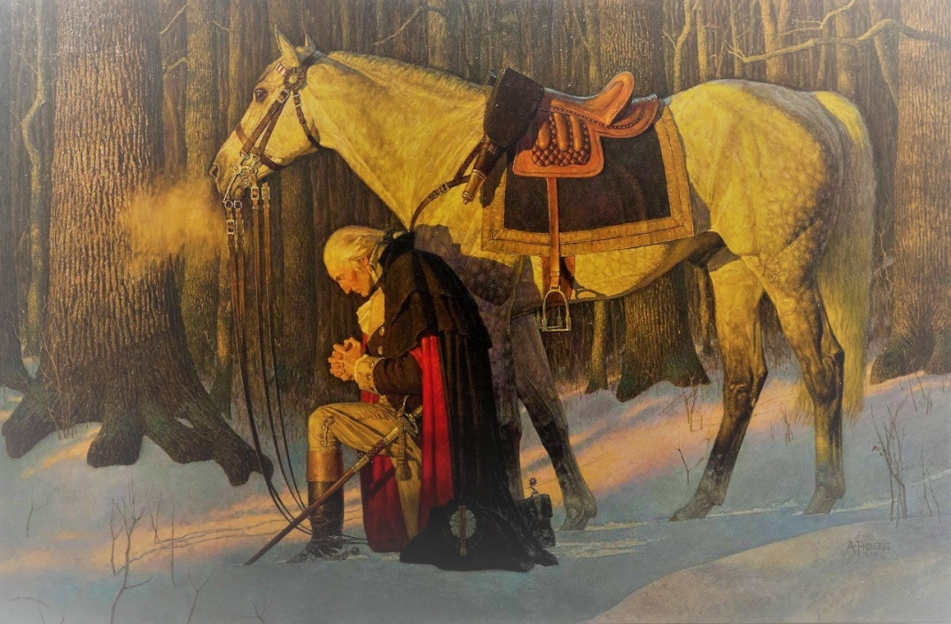
Valley Forge

Slide 13
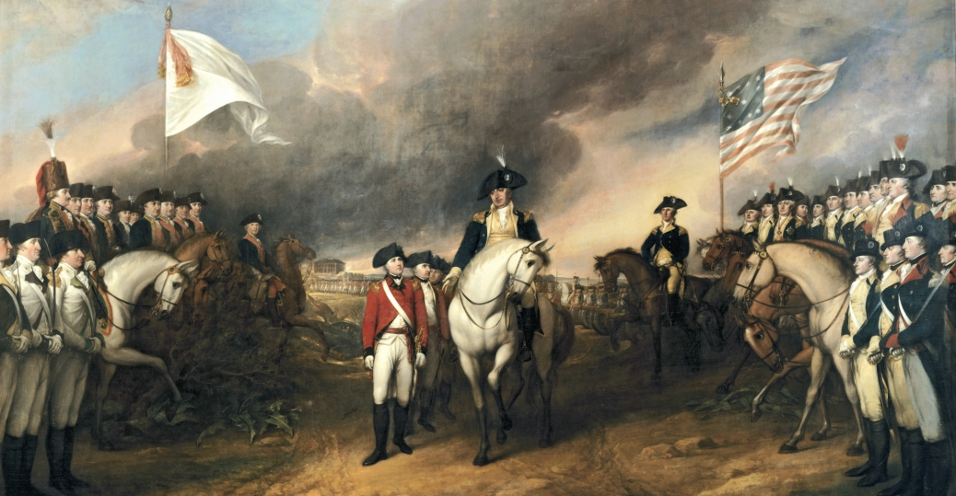
British Surrender at Yorktown

Slide 14
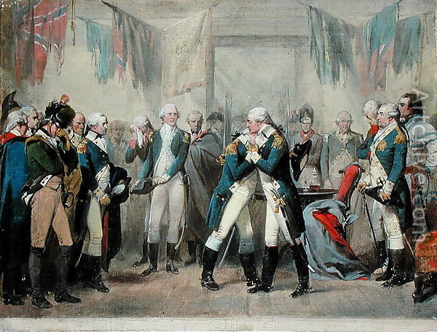
Washington’s Farewell to his Troops

Slide 15
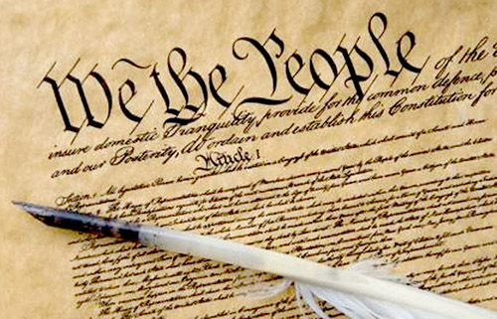
Constitution of the United States of America

Slide 16
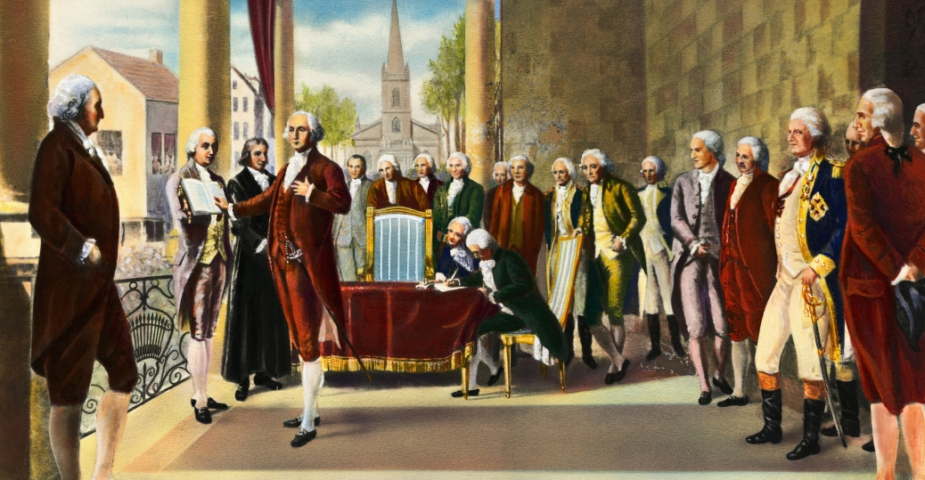
Washington’s Inauguration

Slide 17
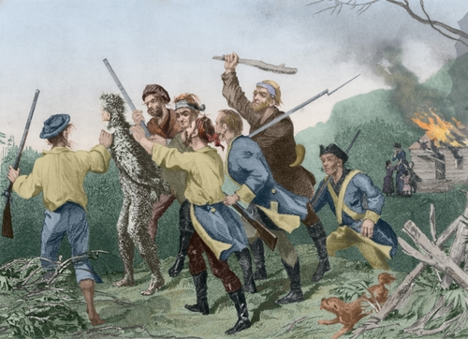
Whiskey Rebellion

Slide 18
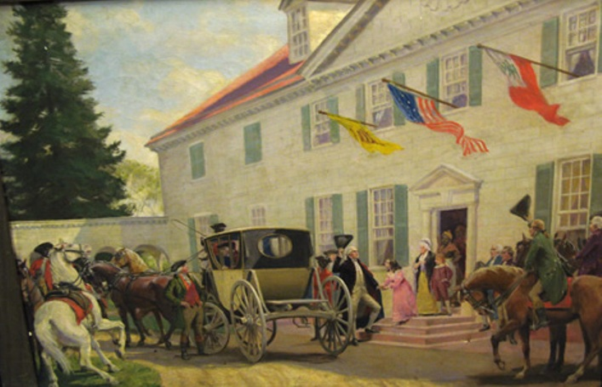
Washington returning to Mt. Vernon

Slide 19
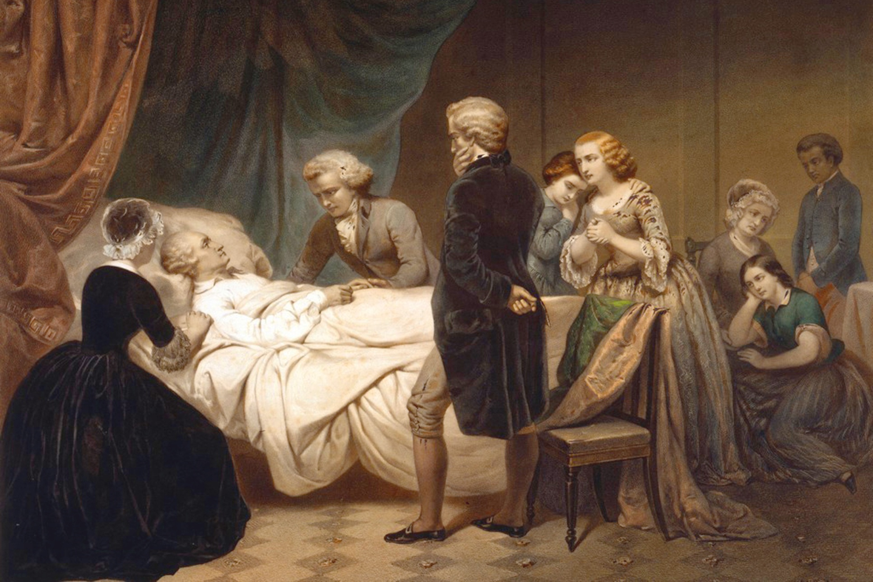
Washington’s Death

Slide 20
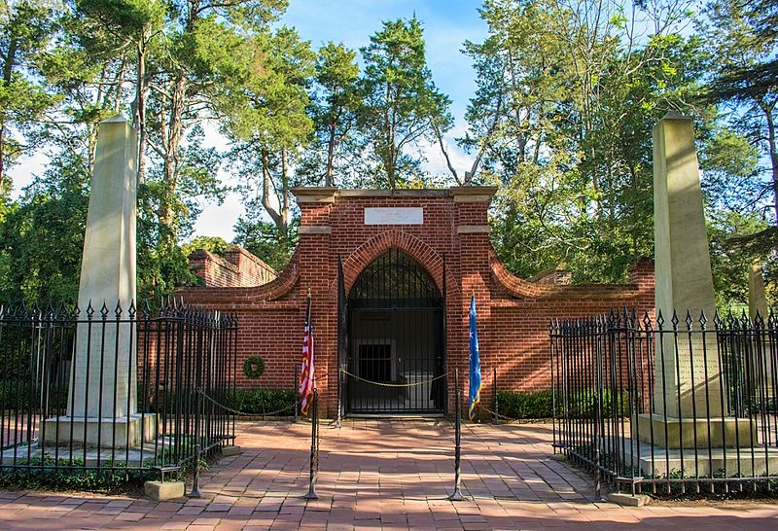
Washington’s Tomb

Slide 21
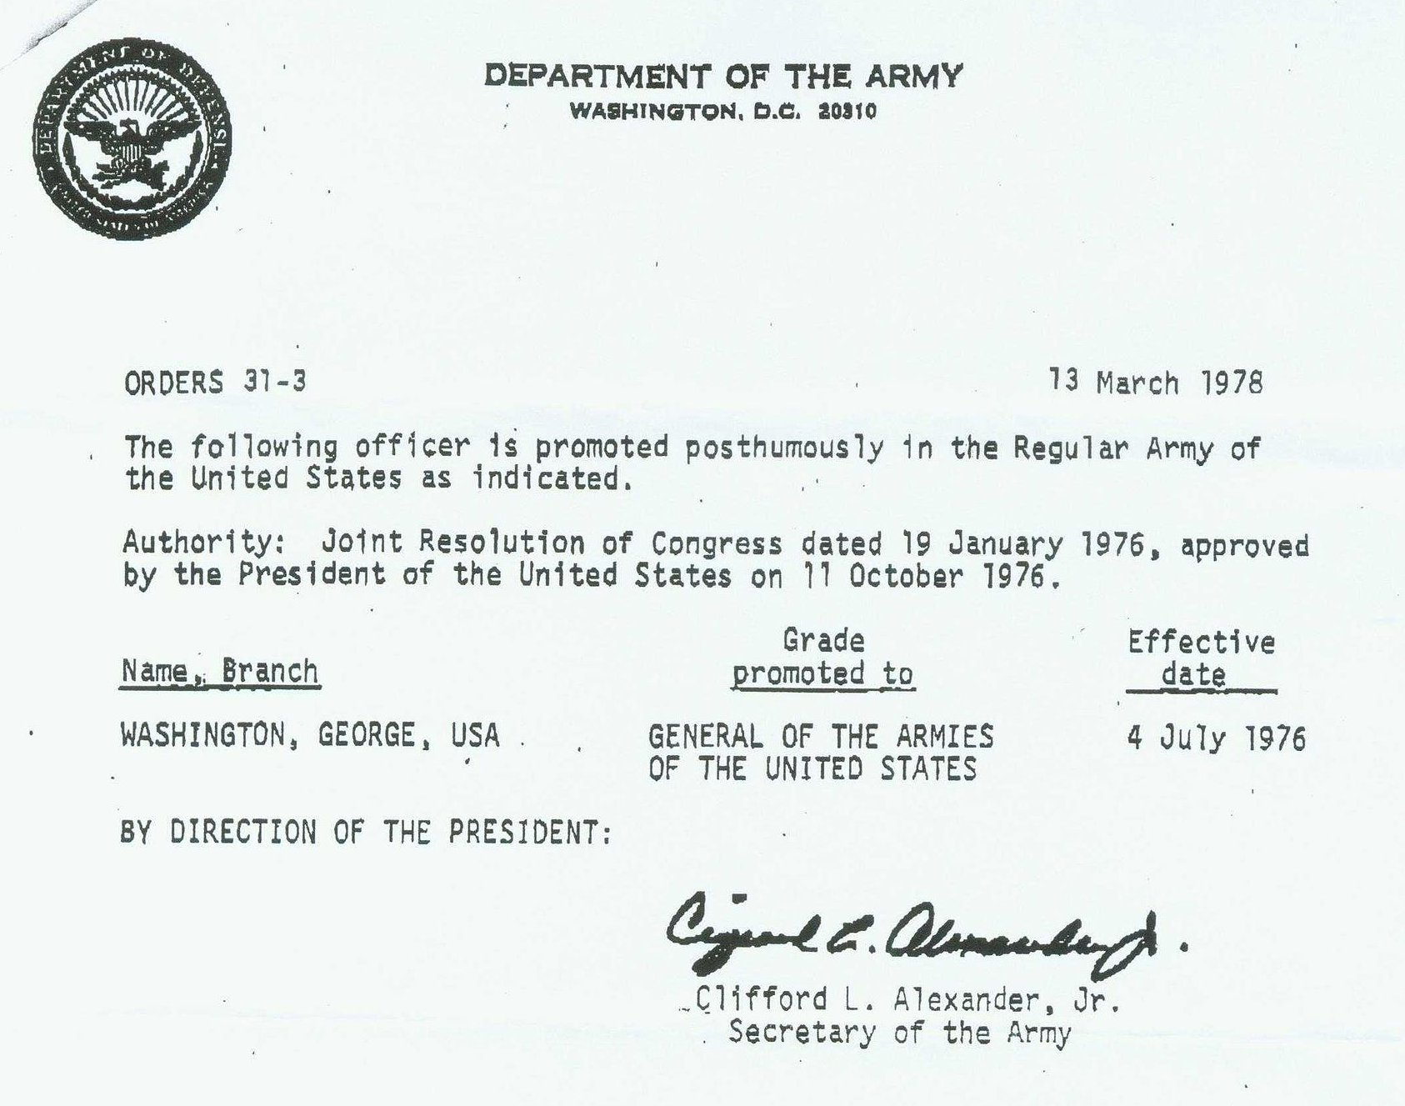
General of The Armies of the United States

Slide 22
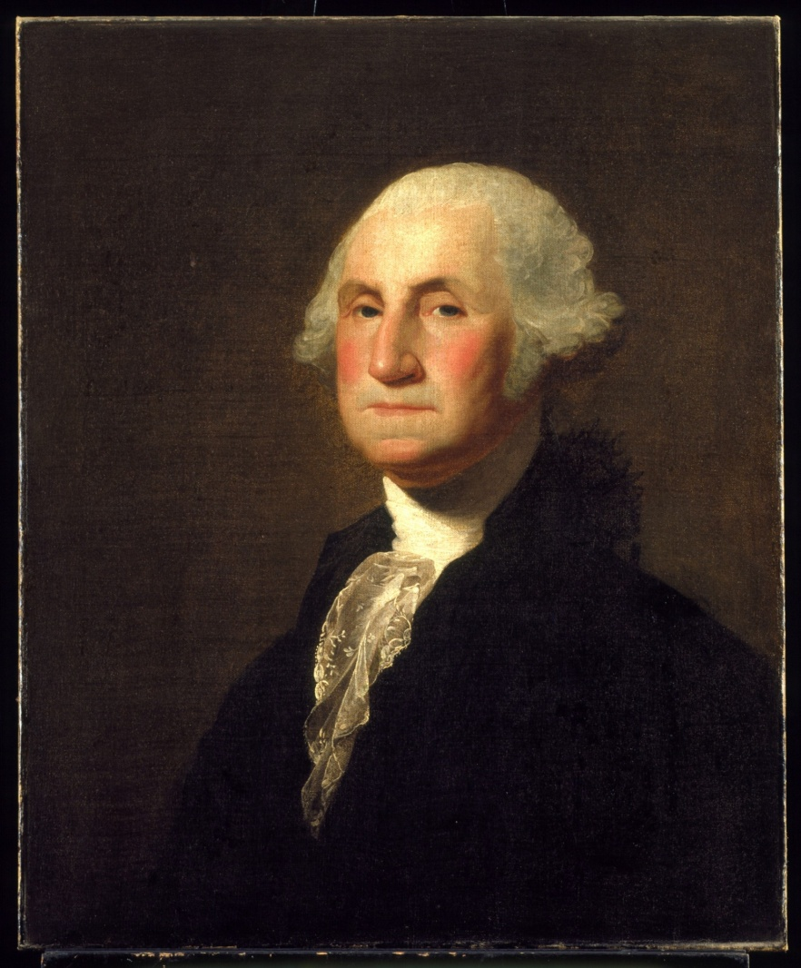
George Washington 1732 - 1799

Slide 23
National Sojourners
Heroes of ‘76
Credits:
George Washington
Script compiled and edited by: Paul A. DeMerath
Vice Chairman (Patriotic Programs)
National Americanism Committee
Slideshow compiled by: Peter G. Cauchon, Area Representative Middle Central North Area
Slideshow Soundtrack from: Middlesex County Fife and Drums
Shenandoah - arr. Ticheli
New World Symphony - Dvorak

